Slide 1
Project Meeting
2018/10/2

Slide 2
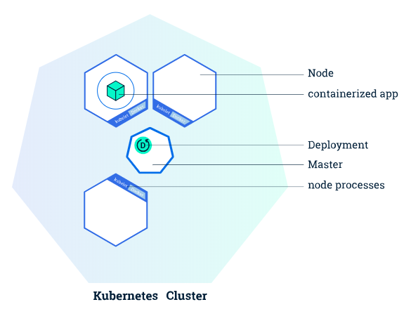
Kubernetes Deployments
Deploy an application
create Nginx service in a Docker container by Kubernetes

Slide 3

Result
Create a node
After deployment Nginx inside

Slide 4
Cluster limit
No more than 5000 nodes
No more than 150000 total pods
No more than 300000 total containers
No more than 100 pods per node

